Slide 1
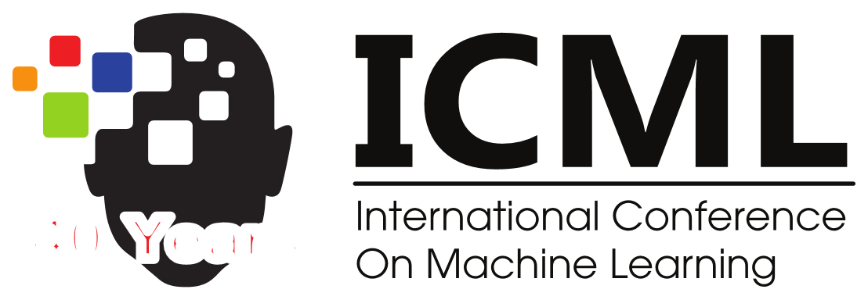


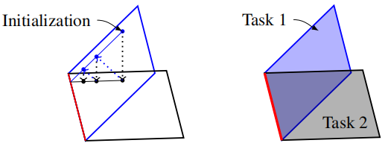
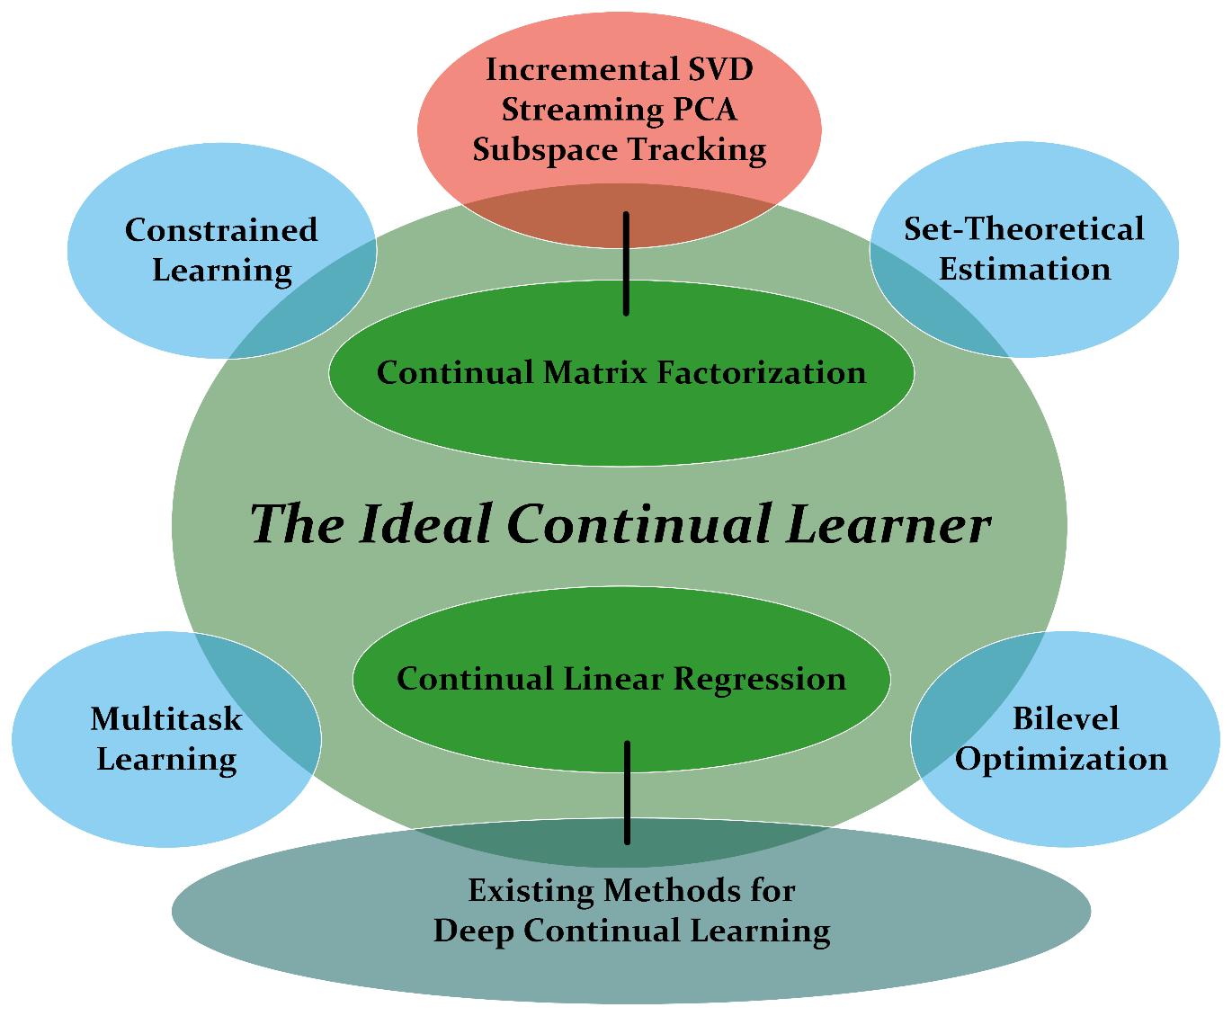
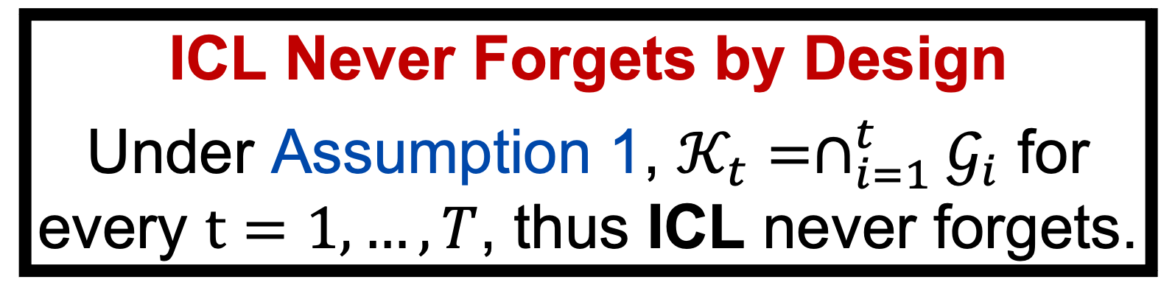

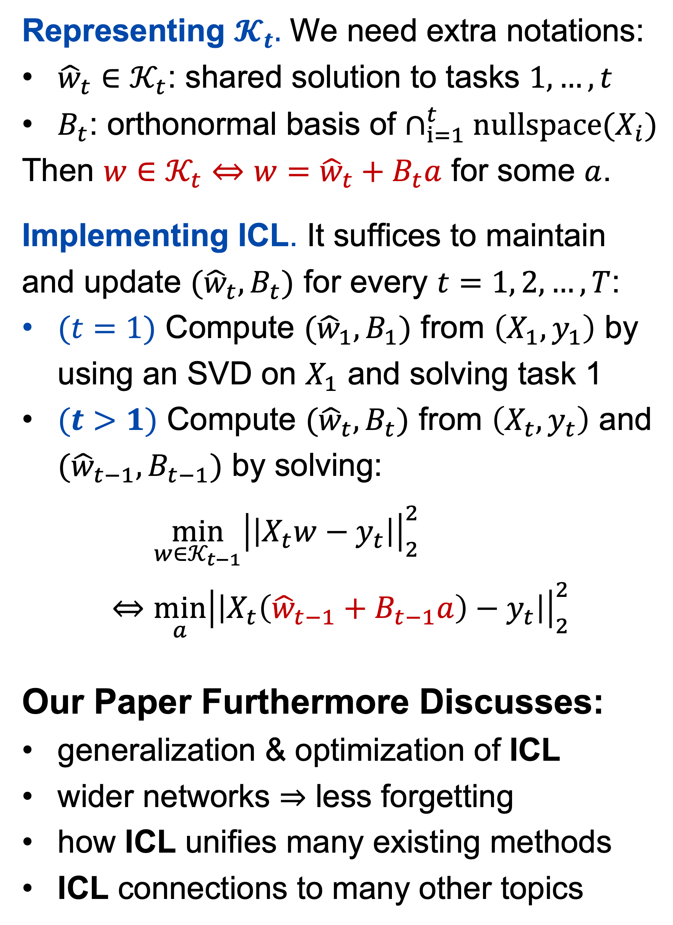
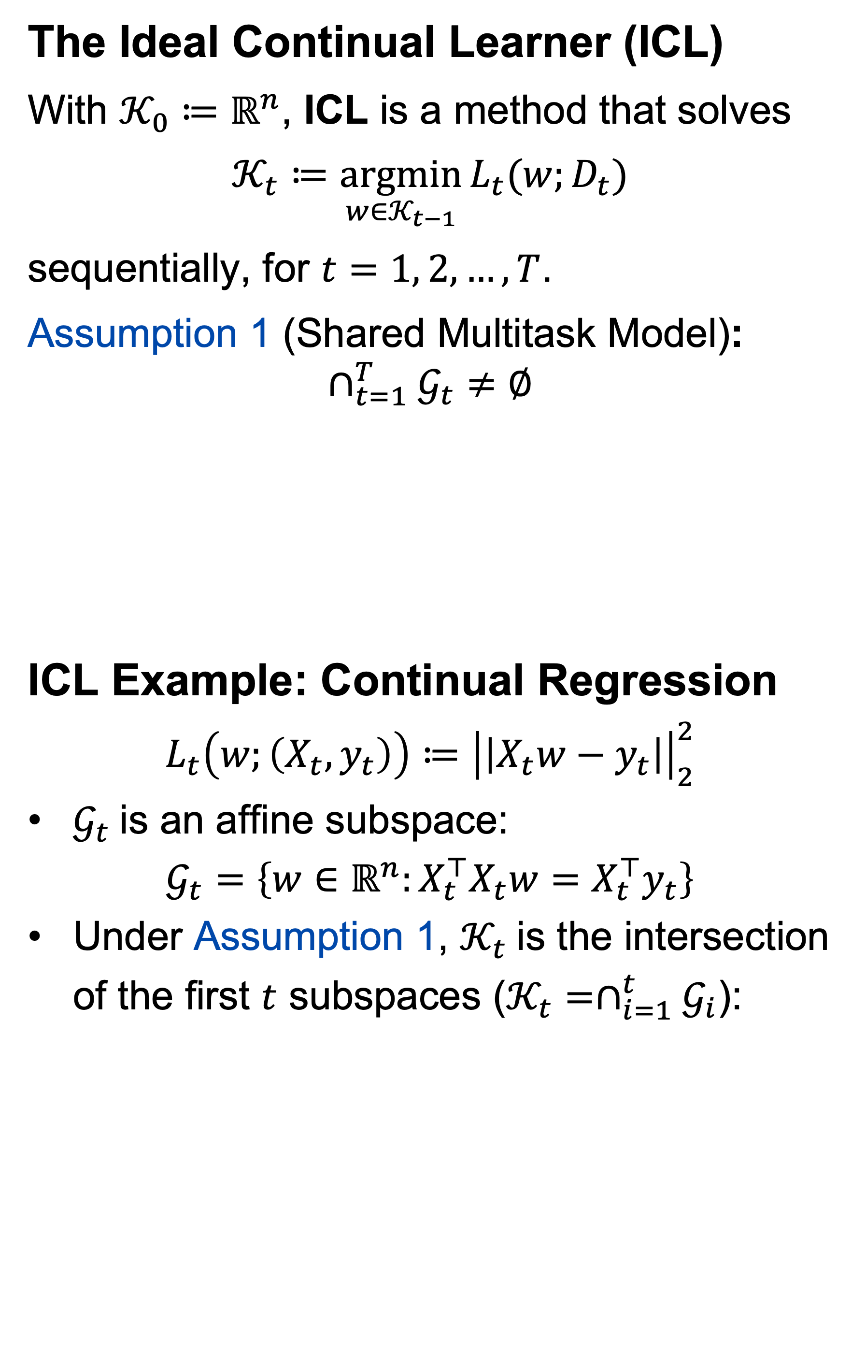


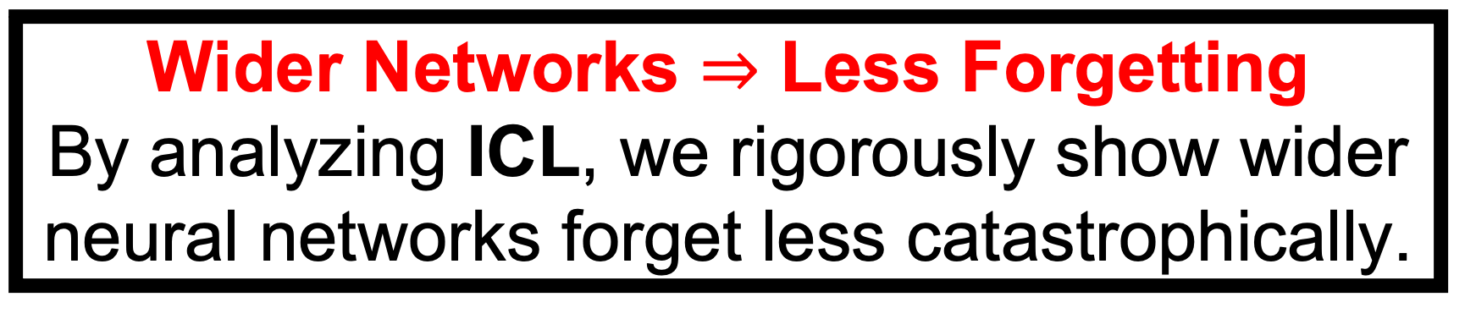
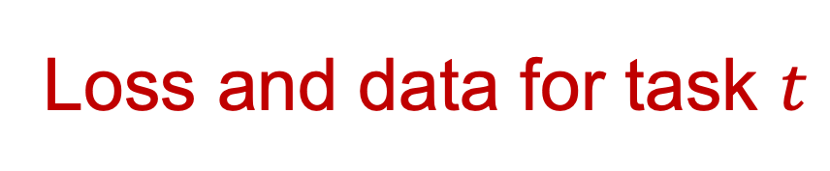
The Ideal Continual Learner: An Agent That Never Forgets
Liangzu Peng¹ Paris V. Giampouras¹ René Vidal^{2,3}
¹JHU ²UPenn ³NORCE Norwegian Research Centre
Continual Learning: Problem Setup
Learning Tasks: Given $T$ tasks, $t=1,…, T$
$$𝒢_{t}≔\underset{w∈ℝ^{n}}{argmin}{L_{t}(w;D_{t})}$$
Goal: learn a model ${\hat{w}}_{T}$ that solves all tasks when presented sequentially to the learner.
Catastrophic Forgetting Challenge: model ${\hat{w}}_{T}$ may perform poorly on previous tasks
Methods to Prevent Forgetting
Regularization-based, e.g.,
$$\min_{w∈ℝ^{n}}{L_{t}\left(w;D_{t}\right)+{δ⋅\left|\left|w−{\hat{w}}_{t−1}\right|\right|}_{2}}$$
Memory-based, e.g., train with current data and part of previous data (rehearsal)
Expansion-based: add new parameters for new tasks and learn only new parameters
These methods greatly improve empirical performance in the deep learning context.
However, there is limited theory explaining their empirical success.
The Ideal Continual Learner (ICL)
With $𝒦_{0}≔ℝ^{n}$, ICL is a method that solves
$$𝒦_{t}≔\underset{w∈𝒦_{t−1}}{argmin}{L_{t}(w;D_{t})}$$
sequentially, for $t=1, 2,…, T$.
Assumption 1 (Shared Multitask Model):
$$∩_{t=1}^{T}𝒢_{t}≠∅$$
ICL Example: Continual Regression
$$L_{t}\left(w;\left(X_{t},y_{t}\right)\right)≔{\left|\left|X_{t}w−y_{t}\right|\right|}_{2}^{2}$$
$𝒢_{t}$is an affine subspace:
$$𝒢_{t}=\left\{w∈ℝ^{n}:X_{t}^{⊤}X_{t}w=X_{t}^{⊤}y_{t}\right\}$$
Under Assumption 1, $𝒦_{t}$is the intersection of the first $t$ subspaces ($𝒦_{t}=∩_{i=1}^{t}𝒢_{i}$):
Representing $𝓚_{t}.$ We need extra notations:
${\hat{w}}_{t}∈𝒦_{t}$: shared solution to tasks $1,…,t$
$B_{t}$: orthonormal basis of $∩_{i=1}^{t}nullspace(X_{i})$
Then $w∈𝒦_{t}⇔w={\hat{w}}_{t}+B_{t}a$ for some $a$.
Implementing ICL. It suffices to maintain and update $({\hat{w}}_{t},B_{t})$ for every $t=1, 2,…,T$:
$(t=1)$ Compute $({\hat{w}}_{1},B_{1})$ from $\left(X_{1},y_{1}\right)$ by using an SVD on $X_{1}$ and solving task 1
$(t>1)$ Compute $({\hat{w}}_{t},B_{t})$ from $\left(X_{t},y_{t}\right)$ and $({\hat{w}}_{t−1},B_{t−1})$ by solving:
$$\min_{w∈𝒦_{t−1}}{{\left|\left|X_{t}w−y_{t}\right|\right|}_{2}^{2}}⇔\min_{a}{{\left|\left|X_{t}\left({\hat{w}}_{t−1}+B_{t−1}a\right)−y_{t}\right|\right|}_{2}^{2}}$$
Our Paper Furthermore Discusses:
generalization & optimization of ICL
wider networks $⇒$ less forgetting
how ICL unifies many existing methods
ICL connections to many other topics
Loss and data for task $t$
Global minimizers for task $t$
ICL Never Forgets by Design
Under Assumption 1, $𝒦_{t}=∩_{i=1}^{t}𝒢_{i}$ for every $t=1,…, T$, thus ICL never forgets.
All Roads Lead to Rome
ICL can be viewed as a regularization-based, memory-based (projection-based), or expansion-based method. Put conversely,
these methods, designed via different insights, are all Ideal Continual Learners.
Rehearsal is an Ideal Continual Learner
We prove the first generalization guarantee for rehearsal, a highly performant memory-based method
$𝒦_{2}$
Wider Networks $⇒$ Less Forgetting
By analyzing ICL, we rigorously show wider neural networks forget less catastrophically.
Conclusion & Limitation:
ICL is a general framework that never forgets
Implementing ICL exactly is in general difficult, but approximating ICL is possible.
Alternating Projection ICL
Acknowledgements: Work supported by the project ULEARN “Unsupervised Lifelong Learning” and co-funded under the grant number 316080 of the Research Council of Norway.
Bunch & Nielsen (1978)
Oja (1982), Yang (1995)
Witsenhausen (1968)
Combettes (1993)
Kieffer et al. (1998)
Chamon et al. (2022)
Caruana (1998)
Vicente & Calamai (1994)

